Slide 1
Conditional Logic
David Tarvin, AIM Code School

Slide 2
What is conditional logic?
Code that makes decisions on what to do based on whether one or more conditions are true or not
Allows the program to run certain blocks of code only if specific conditions are met, and possibly run other blocks of code if those conditions are not met

Slide 3
What is a condition?
Any expression that can be evaluated to true or false
car === “Audi”
accountBalance < 20
jobTitle !== null

Slide 4
If statements
Simplest conditional logic
If the condition is true, code does something
Executes code within if statement code block
If the condition is false, code does nothing
Just moves on to the code that follows the if statement

Slide 5
If statement syntax
if (condition) statement;
// when code to be executed is a single line
if (condition) { // statements }
// when code to be executed is one or more lines

Slide 6
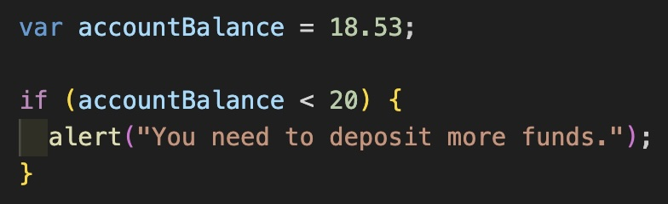
Example of If statement
If the value of accountBalance is less than 20, the alert runs
If the value of accountBalance is 20 or more, nothing happens

Slide 7
If-else statement
If condition is true, something will happen
Code within if code block is executed
If condition is false, something different will happen
Code within else code block is executed
Always guaranteed that code from one of the two code blocks will execute

Slide 8
If-else statement syntax
if (condition) { // statements to be executed if condition is true } else { // statements to be executed if condition is false }

Slide 9
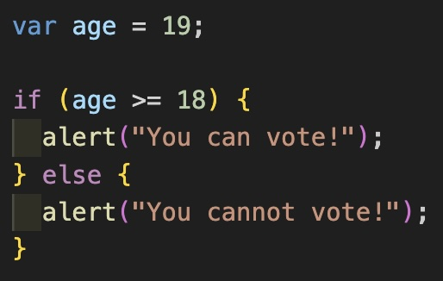
Example of if-else statement
If value of age is greater than or equal to 18, “You can vote!” appears
If value of age is less than 18, “You cannot vote!” appears

Slide 10
If-else if statement
Checks first condition – if it is true executes the code in that condtion’s code block
If first condition is false, checks next condition – if that condition is true executes code in its code block
Keeps checking conditions until one of them is true or they are all false
If one is true, executes code in its code block
If all of them are false, just moves on to code outside the if-else if statement

Slide 11
If-else if statement syntax
if (condition 1) { // statements to be executed if condition 1 is true } else if (condition 2) { // statements to be executed if condition 1 is false but condition 2 is true }

Slide 12
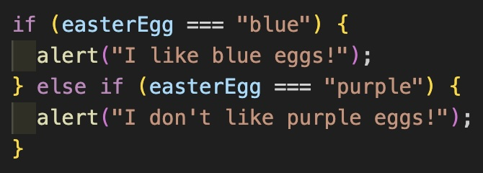
Example of if-else if statement
If value of easterEgg is “blue”, “I like blue eggs!” appears
If value of easterEgg is “purple”, “I don’t like purple eggs!” appears
If value of easterEgg is anything else, nothing appears

Slide 13
If-else if-Else statement
Checks first condition – if it is true executes the code in its code block
If first condition is false, checks next condition – if that condition is true executes code in its code block
Keeps checking conditions until one of them is true or they are all false
If one is true, executes code in its code block
If all conditions are false, executes code in the else code block
Something always guaranteed to execute

Slide 14
If-else if-else statement syntax
if (condition 1) { // statements to be executed if condition 1 is true } else if (condition 2) { // statements to be executed if condition 1 is false but condition 2 is true } else { // statements to be executed if all conditions are false }

Slide 15
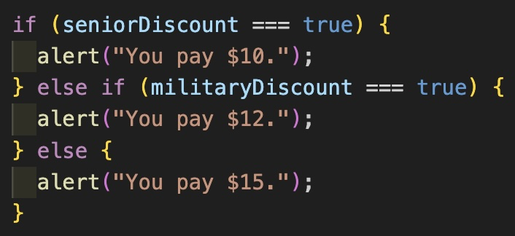
Example of if-else if-else statement
If seniorDiscount is true, “You pay $10” appears
If seniorDiscount is false but militaryDiscount is true, “You pay $12” appears
If if seniorDiscount and militaryDiscount are both false, “You pay $15” appears

Slide 16

Compound conditions
Two or more expressions connected by logical operators
The three main logical operators are:
&& AND
|| OR
! NOT (used in both simple and compound conditions)

Slide 17
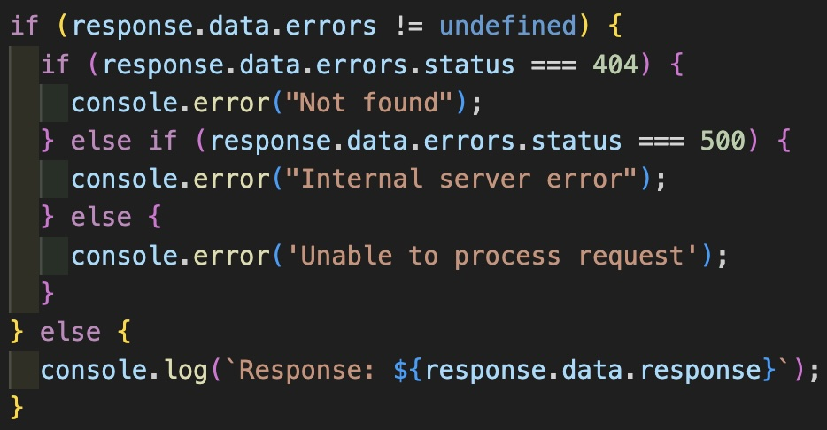
Nesting if statements

Slide 18
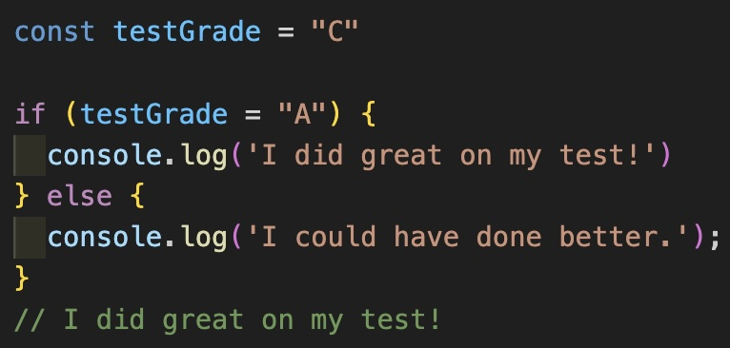
Common error
Using = instead of == or ===
= is the assignment operator, so instead of checking for truthiness it is assigning a new value to the variable

Slide 19
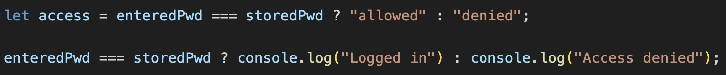
Conditional ternary operators
Has three operands:
operand 1 is the expression to be evaluated
operand 2 is the code that gets executed if operand 1 is true
operand 3 is the code that gets executed if operand 1 is false
Syntax: operand1 ? operand2 : operand3;

Slide 20
Switch statements
Purpose – run different blocks of code based on the value of a single expression
Better than writing a long change of if…else if…else statements when comparing the same value to multiple possibilities
Best when evaluating more than four or five values

Slide 21
Switch statement syntax
switch(expression) { case value1: // code to be executed break; case value2: // code to be executed break; case value-n: // code to be executed break; default: // optional code to be executed when no cases match break; }

Slide 22
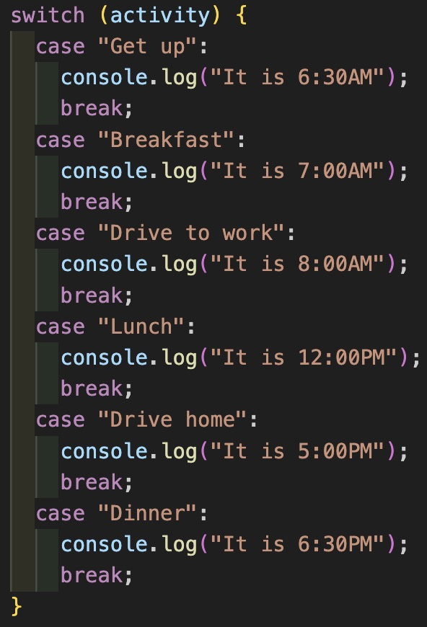
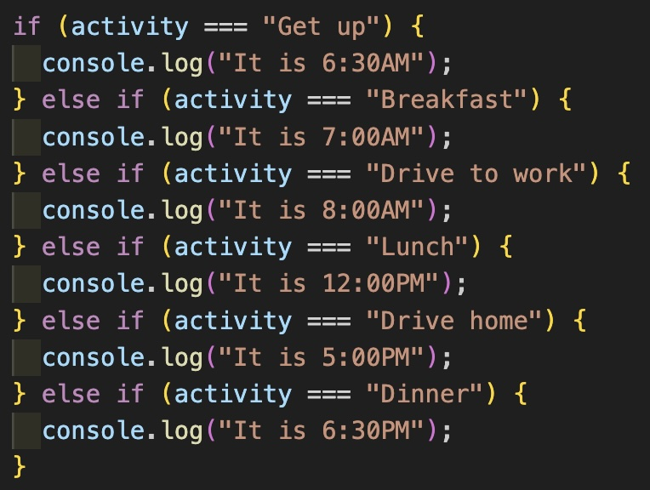

Slide 23
Break;
Need break; at the end of each case to prevent JavaScript from executing code in the next case also
Even though comparison of next value to expression will be false, that code will still be executed if break statement not executed before reaching it
If no break statements at all in switch statement, all code for all cases following the matching case will execute

Slide 24
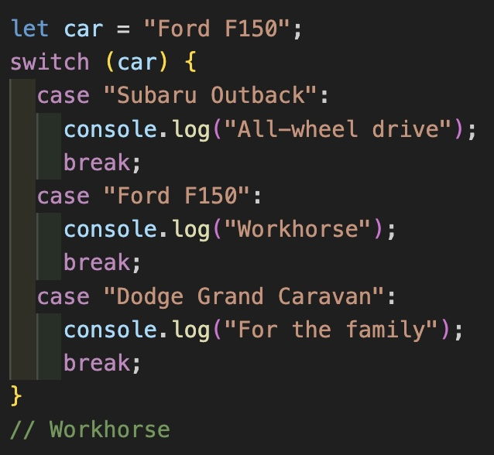
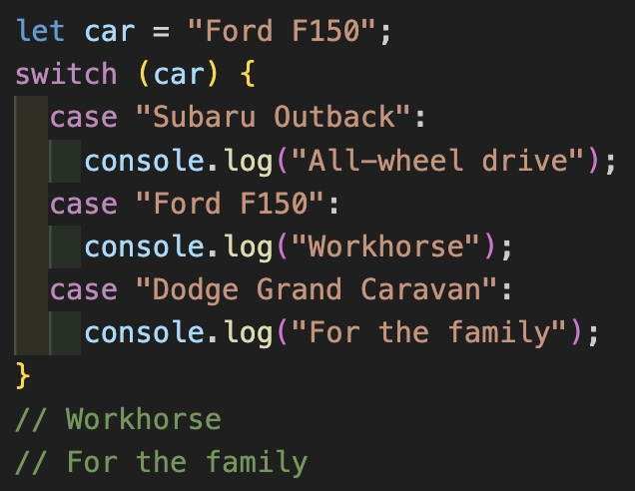

Slide 25
Default:
Optional case with code that runs when none of the other cases match
Usually goes at the bottom of switch statement, but will still work properly even if at the top or in the middle of statement

Slide 26
